Slide 1
Spreadsheet

Slide 2
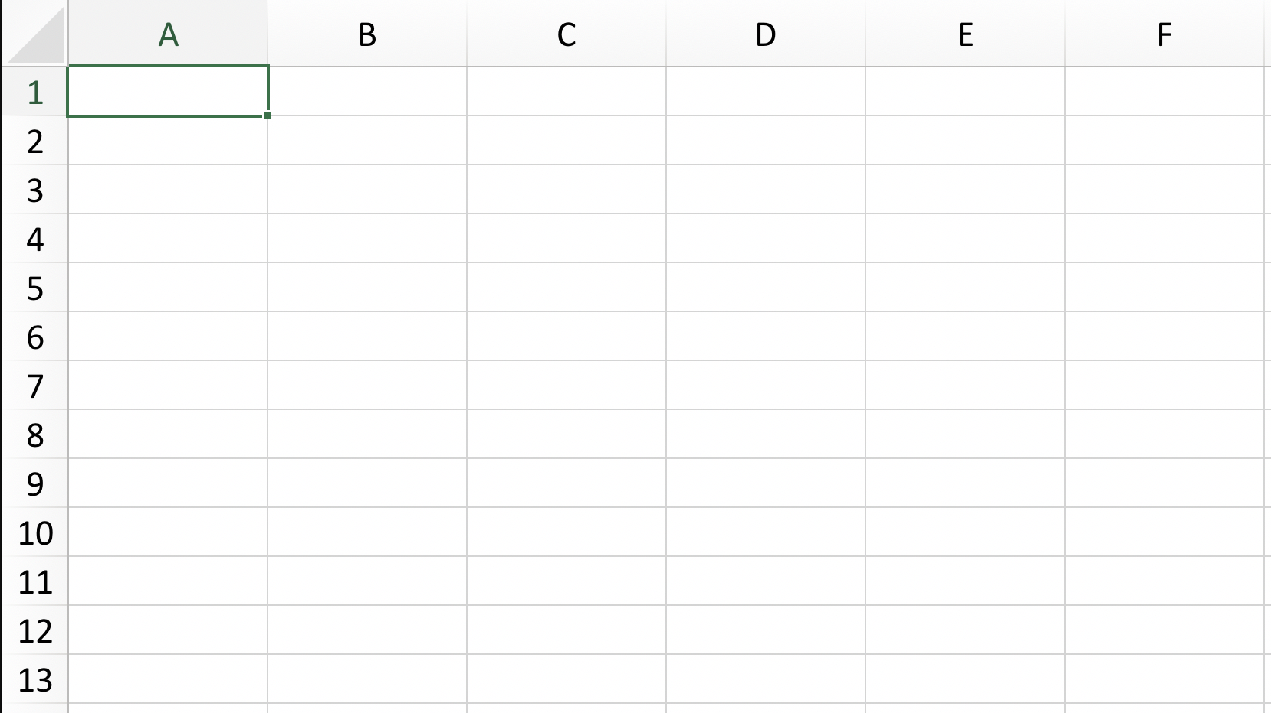
Spreadsheet
Column
A1
Cell reference
C4
B10
Row

Slide 4
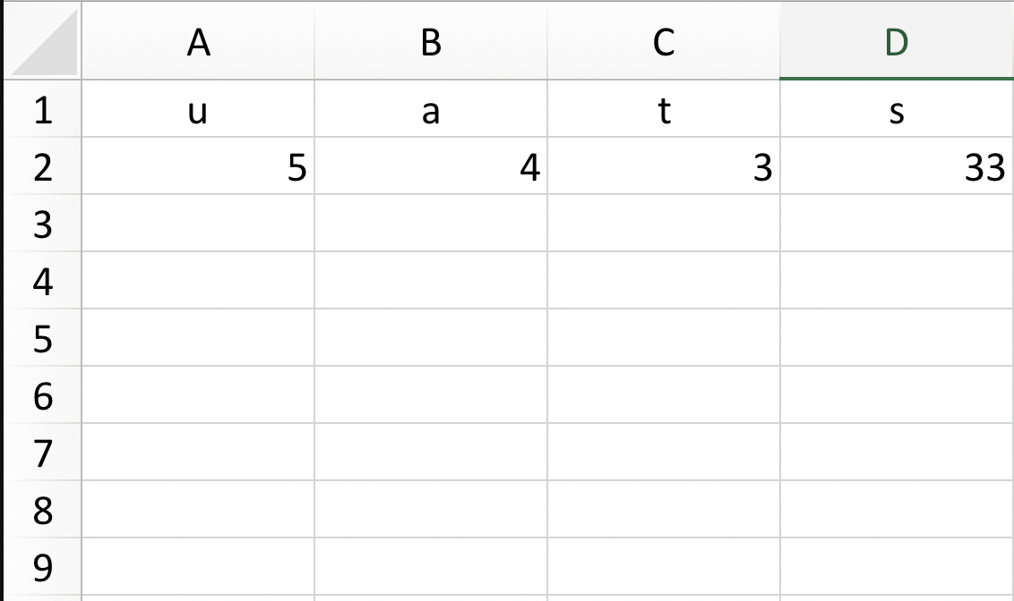
s = ut + ½ at²
= A2*C2+0.5*B2*(C2)^2

Slide 5
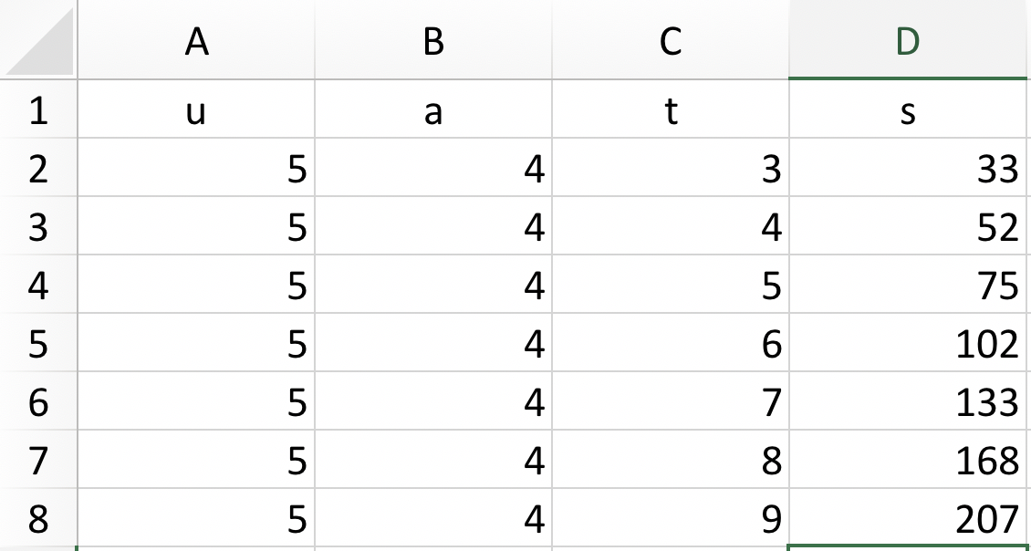
= A2*C2+0.5*B2*(C2)^2
= A3*C3+0.5*B3*(C3)^2

Slide 6
Useful functions
Cell reference
$ in front of the column (or row) means that the position of the column (or row) dost not change
$B$5 – you will always refer to the cell B5
$B5 – the row can change but the column does not change, always B
B$5 – the column can change but the row does not change, always 5
Addition (+), subtraction (-), multiplication (*), division (/), power (^)
=sum(A2:A8) means =A2+A3+A4+A5+A6+A7+A8
Other functions – explore on your own

